Slide 1
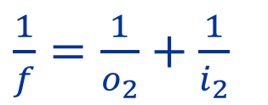
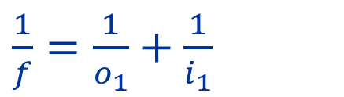
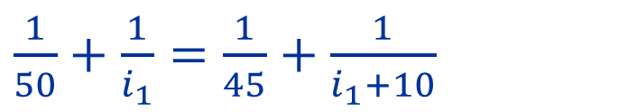
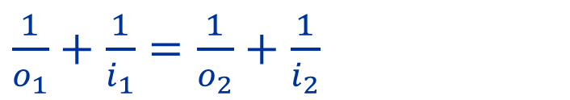
3. An object is placed 50 cm away from a lens. The lens produces a real image of the object. If the object moves 5 cm closer to the lens, it’s image moves 10 cm. Calculate the focal distance of the lens!
$\frac{1}{f}=\frac{1}{o_{1}}+\frac{1}{i_{1}}$
$\frac{1}{o_{1}}+\frac{1}{i_{1}}=\frac{1}{o_{2}}+\frac{1}{i_{2}}$
$\frac{1}{f}=\frac{1}{o_{2}}+\frac{1}{i_{2}}$
$\frac{1}{50}+\frac{1}{i_{1}}=\frac{1}{45}+\frac{1}{i_{1}+10}$
$45i_{1}\left(i_{1}+10\right)+2250\left(i_{1}+10\right)=50i_{1}\left(i_{1}+10\right)+2250i_{1}$
$5i_{1}^{2}+50i_{1}−22500=0$

Slide 2
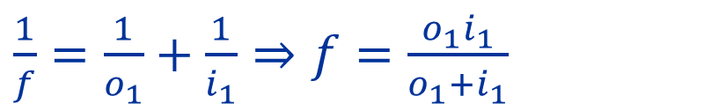

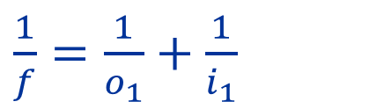

3. An object is placed 50 cm away from a lens. The lens produces a real image of the object. If the object moves 5 cm closer to the lens, it’s image moves 10 cm. Calculate the focal distance of the lens!
$\frac{1}{f}=\frac{1}{o_{1}}+\frac{1}{i_{1}}$
$5i_{1}^{2}+50i_{1}−22500=0$
$\frac{1}{f}=\frac{1}{o_{2}}+\frac{1}{i_{2}}$
$$62.27cm$$
${\left(i_{1}\right)}_{1,2} =\frac{−50±\sqrt{2500+4⋅5⋅22500}}{2⋅5}=\frac{−50±672.7}{10}$
$$−72.27cm$$
$\frac{1}{f}=\frac{1}{o_{1}}+\frac{1}{i_{1}}⇒f=\frac{o_{1}i_{1}}{o_{1}+i_{1}}$
$f=\frac{o_{1}i_{1}}{o_{1}+i_{1}}=\frac{50⋅62.27}{50+62.27}=27,73cm$

